Slide 1
Containers and Modern DevOps
Nick Kwiatkowski, MMCFUG
11/14/23

Slide 2
Agenda
What are containers?
A picture of a modern DevOps pipeline
Developer workflow using containers
Moving apps from Dev to Test to Production in your own DC
Moving apps from Dev to Test to Production in the public cloud

Slide 3
What are containers?

Slide 4
Introduction to Containers
Containers are essentially portable, virtual machines built on layers of software used to stand up services.
They are designed to run single-purpose, small applications.
Containers make it easy for developers to build these images and script the movement of code from dev to test to production, regardless of where those are.
Multiple containers are grouped together to form your application.

Slide 5
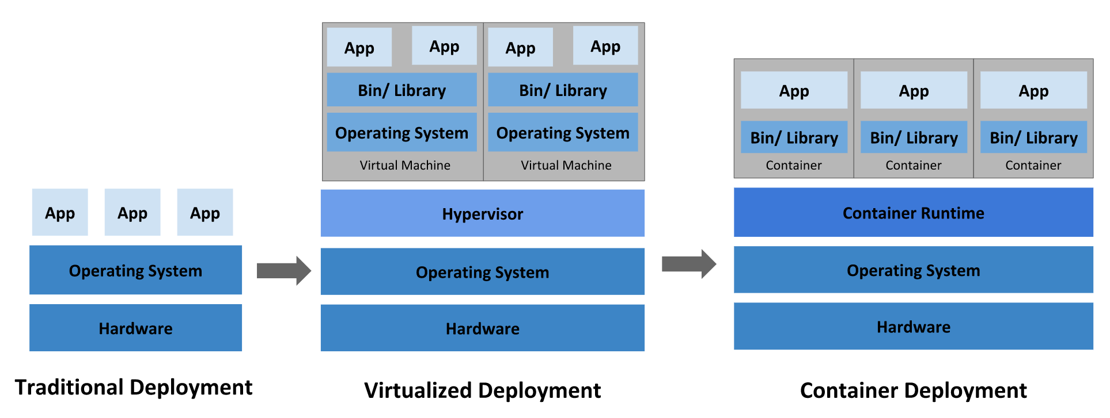
Introduction to Containers

Slide 6
Introduction to Containers
Containers are themselves built on “Images” and Images are built on Layers.
Layers are reusable snapshots of a hard drive that, when combined build your image that is used to run the container.
The base image, usually the kernel of your operating system would be either a Linux base or Windows. From there you would add in all the things to run your solution.
E.g. Linux Base + Java + Tomcat + Lucee.
There is no limit to the number of layers to build your solution.

